Slide 1
CSE 3105
Software Engineering

Slide 2
What is software quality?

Slide 3
The transcendental view argues that quality is something that you immediately recognize, but cannot explicitly define.
The user view sees quality in terms of an end user’s specific goals. If a product meets those goals, it exhibits quality.
The manufacturer’s view defines quality in terms of the original specification of the product. If the product conforms to the spec, it exhibits quality.
The product view suggests that quality can be tied to inherent characteristics (e.g., functions and features) of a product.
The value-based view measures quality based on how much a customer is willing to pay for a product. In reality, quality encompasses all of these views and more.

Slide 4
An effective software process applied in a manner that creates a useful product that provides measurable value for those who produce it and those who use it.

Slide 5
Garvin’s Quality Dimensions
Performance quality: Does the software deliver all content, functions, and features that are specified as part of the requirements model in a way that provides value to the end user?
Feature quality: Does the software provide features that surprise and delight first-time end users?
Reliability: Does the software deliver all features and capability without failure? Is it available when it is needed? Does it deliver functionality that is error-free?
Conformance: Does the software conform to local and external software standards that are relevant to the application?

Slide 6
Garvin’s Quality Dimensions
Durability: Can the software be maintained (changed) or corrected (debugged) without the inadvertent generation of unintended side effects? Will changes cause the error rate or reliability to degrade with time?
Serviceability: Can the software be maintained (changed) or corrected (debugged) in an acceptably short time period? Can support staff acquire all information they need to make changes or correct defects?
Aesthetics: an aesthetic entity has a certain elegance, a unique flow, and an obvious “presence” that are hard to quantify but are evident nonetheless.
Perception.

Slide 7
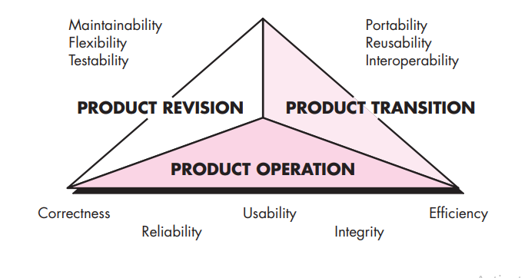
McCall’s Quality Factors

Slide 8
ISO 9126 Quality Factors
Functionality
Reliability
Usability
Efficiency
Maintainability
Portability

